Slide 1
Intergalactic Bookstore (WIP)
Level 4/5 Group 14
Alex Polley
Ryan Manthorp
Thomas McLaren
Daniel Pokladek

Slide 2
Summary
Emotions:
Vellichor
Monachopsis
Play as a boostore keeper organising bookshelfs, bookstore contains priceless and dangerous books. Bookstore turns out to be in space

Slide 3
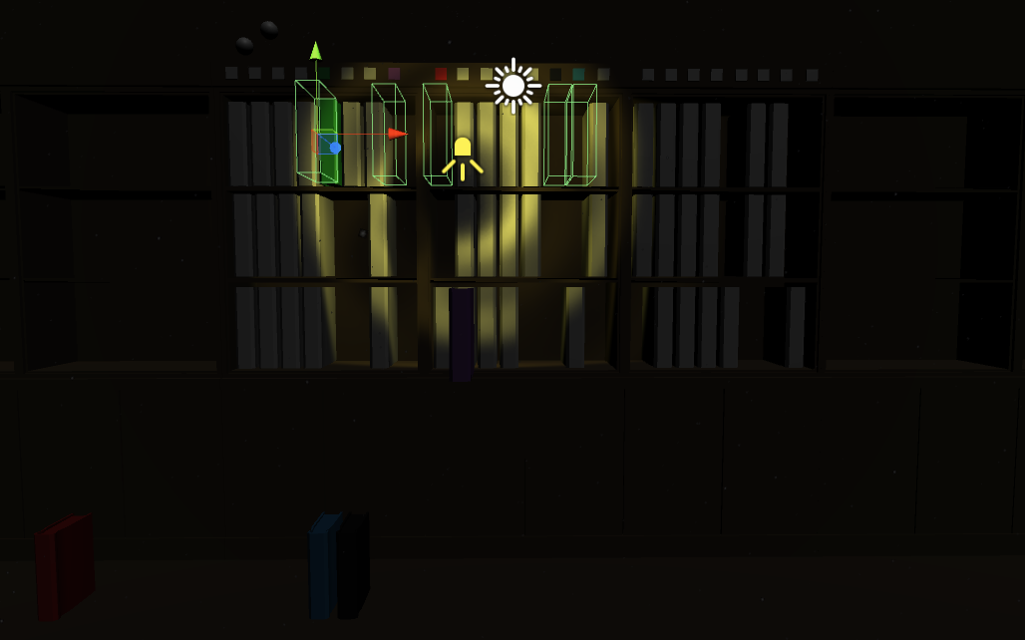
Gameplay | Daniel, Tom
Moving books to perfectly fit the shelf
Fill up the shelf so there is no more space
Unlock door and proceed to the next puzzle
Higher levels introduce different sizes, stacking and space mites
Space mites try to destroy the books
Video Demonstration: <THEY PLAYED US LIKE A DAMN FIDDLE.mov>

Slide 4
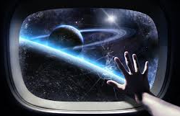
Emotions
Vellichor- We evoke this emotion by having our game players environment being within a a second hand bookshop. The environment inlcudes dust particles and book covers have a grimey texture to show there age and help evoke the emotion.
Monachopsis-To trigger this emotion for the player, we will be giving small hints that the used bookshop the player is inside, is located in space.
We will do this by introducing space mites within our puzzles and also have a window within the bookshop in which you can see earth in the distance. Also the gravity with be slightly slower.

Slide 5
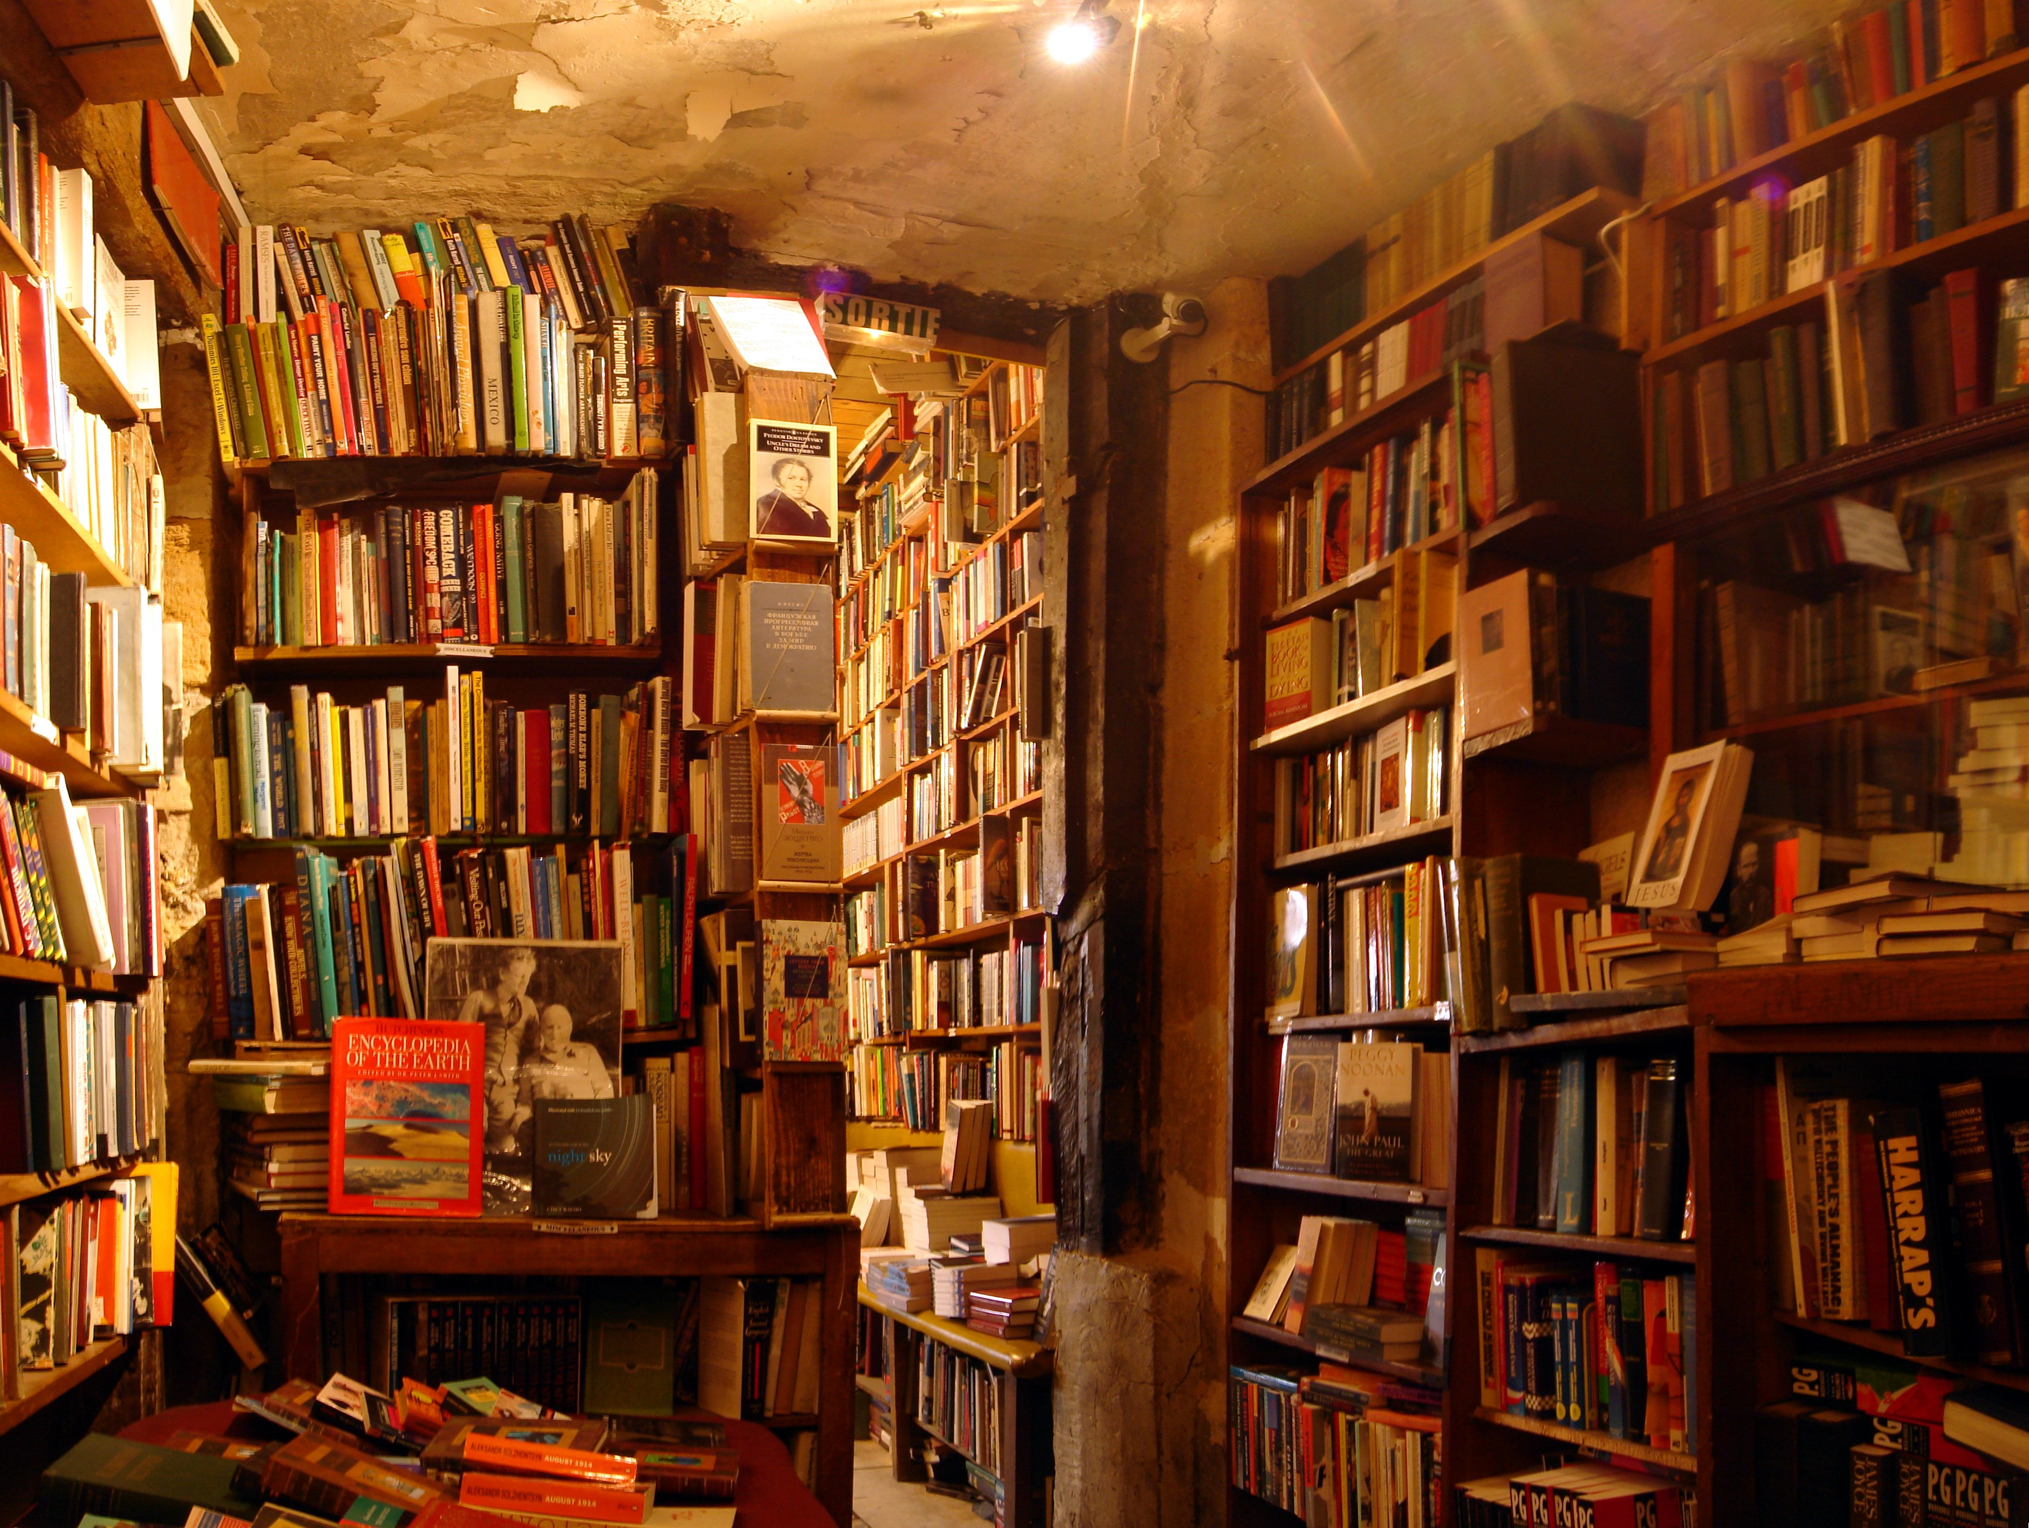
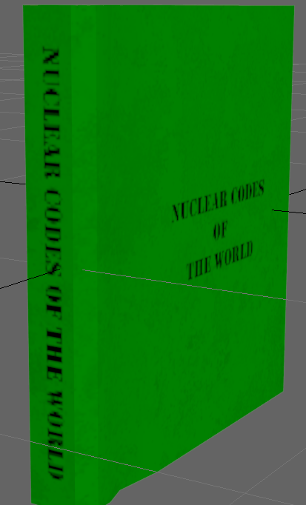
Design/ art choices
All books have grime and dirt on them to give them a old and vintage look
Rooms are dimly lit with warm lighting to make the player feel as if they are in a old bookstore

Slide 6
Changes made
Ryan

Slide 7
Management
Emails sent
Alex- 3
Ryan- 1
Tom- 4
Daniel- 2
Hours logged

Slide 8
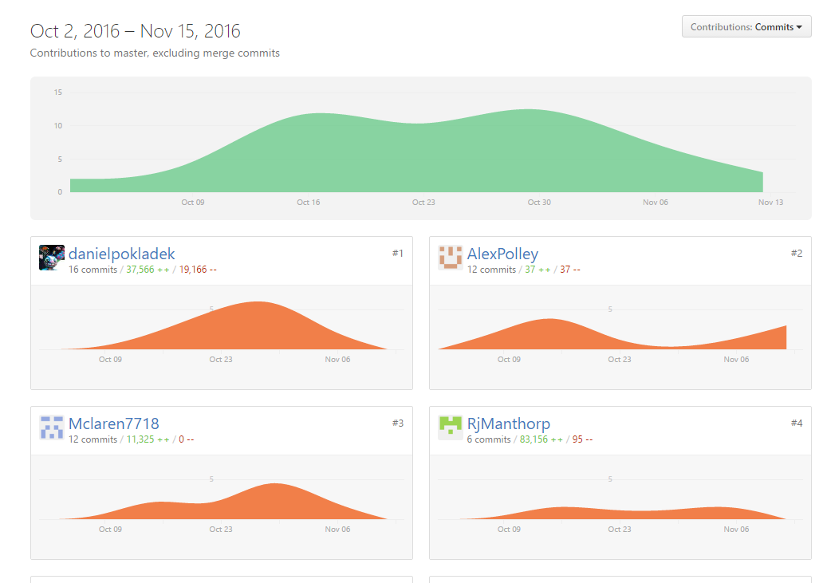
Weekly commits

